Slide 1


DIVERSIFICATION
STRATEGIES
Presented by: TEAM 12

Slide 2
overview
1.Vertical Diversification
2.Horizontal Diversification
3.Concentric Diversification
4.Conglomerate Diversification

Slide 3

VERTICAL DIVERSIFICATION
A company expands its operations either forward or backward within its supply chain. This means the company enters into new activities that are either closer to the source of raw materials (backward integration) or closer to the final consumer (forward integration).
Early Beginnings - Reliance started its journey in the textile industry, focusing on manufacturing and marketing polyester textiles. The company's initial success was largely due to Dhirubhai Ambani's vision for cost efficiency and quality.
Vertical Integration in Petrochemicals - In the late 1970s, RIL ventured into petrochemicals, establishing a naphtha cracker plant. This marked the beginning of its vertical integration strategy. By controlling the supply chain from raw materials to finished products, Reliance could reduce costs and enhance quality. This strategy not only improved profit margins but also allowed RIL to respond swiftly to market changes.

Slide 4
Example: The naphtha cracker facility enabled RIL to produce a range of products, including polyethylene and polypropylene, which were essential for various industries, including packaging, automotive, and consumer goods.
Benefits of Vertical diversification
Cost Control
Quality Assurance
Market Responsiveness

Slide 5
HORIZONTAL DIVERSIFICATION
A company expands its product or service offerings by entering into new markets or industries that are unrelated to its existing operations.
Expansion into Related Industries - As RIL established its dominance in petrochemicals, it explored horizontal diversification by entering related industries. This strategy allowed the company to leverage existing capabilities and market presence.
Entry into Refining - In the 1990s, RIL expanded horizontally into oil refining, launching the world's largest refinery in Jamnagar. This move complemented its petrochemical operations and significantly enhanced its revenue streams.

Slide 6
Example: The Jamnagar refinery processes crude oil into a variety of products, including gasoline, diesel, and jet fuel, creating a synergy between its refining and petrochemical segments.
Benefits of Horizontal diversification
Increase market share
Enhance brand recognition
Cross-promotion opportunities

Slide 7


CONCENTRIC
DIVERSIFICATION
Concentric diversification is a business growth strategy where a company expands its product lines or markets by offering new products or services that are related to its existing core business. This approach leverages the company's existing strengths, such as its brand, technology, or distribution channels, while allowing it to tap into new markets. The key to concentric diversification is that the new products or services share similarities with the company's current operations, allowing the company to benefit from synergies.

Slide 8

Reliance originally started with textiles but expanded into petrochemicals, which was a logical extension because petrochemicals are crucial raw materials for synthetic fibers used in textiles. This move allowed the company to integrate its supply chain vertically, controlling both the production of raw materials and the final product.
Petrochemicals
Building on its expertise in petrochemicals, Reliance moved into oil refining and later oil and gas exploration. Both of these businesses were related to its petrochemical business in terms of the required technology, infrastructure, and raw materials.
Oil Refining
telecommunication
(Jio)
Reliance’s launch of Jio, a major telecommunications player, can also be seen as concentric diversification. Although not directly related to its core petrochemical business, it leveraged Reliance’s financial strength, existing distribution networks, and technological expertise. Jio's expansion capitalized on the company’s ability to deploy large-scale infrastructure projects, similar to its other large ventures.
Reliance leveraged its telecom infrastructure to expand into digital services, such as JioTV, JioSaavn (music streaming), JioMeet (video conferencing), and JioCinema (streaming services). These offerings are related to its telecommunications business and enhance customer engagement by providing a full ecosystem of digital products.
digital services

Slide 9

CONGLOMERATE DIVERSIFICATION
Overview of Conglomerate Diversification
Conglomerate diversification involves entering entirely different industries, often unrelated to the company’s core business. This strategy can reduce risk and stabilize income streams.

Slide 10

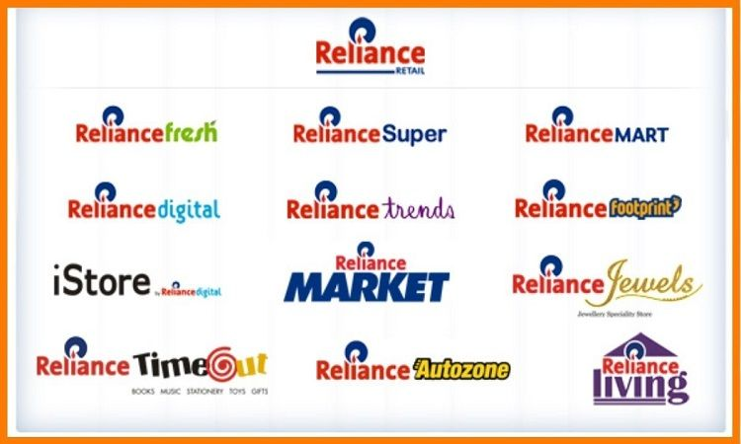
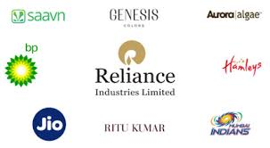
RELIANCE Entry into Retail and Other Sectors

Slide 11
Benefits of Conglomerate Diversification
The conglomerate approach has provided RIL with:
Risk Mitigation: By operating in diverse industries, RIL can cushion itself against downturns in any single sector.
Capitalizing on Growth Opportunities: Investing in high-growth sectors, such as retail and digital media, has opened new revenue streams.
Access to New Markets: The conglomerate model allows RIL to enter markets that may have been previously inaccessible, broadening its global footprint.

Slide 12
Strategic Partnerships and Investments
1. Strategic Partnerships:
- Google Investment:
Google invested $4.5 billion for a 7.73% stake in Jio Platforms.
- Partnership with Microsoft:
Strategic partnership to use Microsoft Azure cloud services for Jio’s enterprise and consumer services.
- BP and Reliance in Energy:
Formed a joint venture with BP (British Petroleum) to develop fuel retail and mobility solutions.
.

Slide 13
2. Investments:
- Jio Platforms Investments:
Raised over $20 billion from global investors like Meta, Google, Silver Lake, and KKR.
Focus on expanding digital services, e-commerce, and telecom infrastructure across India.
- Retail Expansion:
Investment in Reliance Retail by Silver Lake, KKR, and Mubadala to expand offline and online retail dominance.
Strategic acquisitions of brands like Future Group to grow its market share in retail.
- Focus on 5G and Digital Expansion:
Investments in 5G infrastructure and related technologies.
Strategic acquisitions in the technology sector to build an end-to-end digital ecosystem.

Slide 14
Challenges and Risks:
1. Regulatory Challenges:
- Increasing scrutiny from government bodies related to monopoly concerns, especially in telecom and retail sectors.
2. Competition:
- Fierce competition from global giants like Amazon, Walmart (via Flipkart), and Google in both retail and digital services.
3. Oil-to-Chemicals Dependency:
- Reliance's traditional core business in oil and petrochemicals faces risks from volatile oil prices and the global shift towards renewable energy.

Slide 15
4. Execution Risk in Green Energy Transition:
- Reliance's ambitious goals to pivot towards green energy involve large-scale investments in solar, hydrogen, and renewable technologies.
5. Supply Chain Disruptions:
- Global supply chain issues, as seen during the COVID-19 pandemic, could affect Reliance’s retail and manufacturing operations.
.

Slide 16


QUESTION
1) How do you plan to enhance your business strategy by expanding your product line to reach new customer segments through horizontal diversification?
2) How do you intend to improve efficiency and reduce costs by integrating supply chain processes through vertical diversification?
3)How did Reliance's entry into renewable energy align with their existing oil and gas business?

Slide 17

Thank you!

